Slide 1
Power Calculation and Study Design
Regional Research and Data Summit – Latin America and the Caribbean
Lima, Peru| August 2019
Steven Glazerman

Slide 2
Topics
Power calculation: intro and definitions
Simple RCT
Stratification, covariates
Choosing outcomes and subgroups
Choosing a target MDE/MDI
Cluster randomized trial
Multiple levels of clustering
Multiple treatment arms
Factorial experiments
Multiple comparison problem
Quasi-experimental designs
Design considerations for maximizing statistical precision
Baseline surveys and other types of covariate data
Stratified or paired randomization
Noncompliance and attrition
Balanced vs. unbalanced samples (optimal allocation of sample across treatment arms)
Software for power calculation

Slide 3
Power calc: intro and definitions

Slide 4
Power Calculation
Study Design
Motivation
It’s not just a math problem.
Goal is to determine if study is designed well enough to answer the research question.
“Minimize error variance subject to cost constraint”
In plain language: “Set up sample size, covariate data, randomization, etc. such that if there is a policy-relevant effect, we have a good chance of detecting it”

Slide 5
Definitions and Notation
H₀ = Null hypothesis (e.g. impact = zero)
H_{a} = Alternative hypothesis
α = Prob(reject H₀|H₀) = Prob (false positive) = Prob(Type I error)
β = Pr(fail to reject H₀|H_{a}) = Prob(false negative) = Prob(Type II error)
Power = 1 – β ← Depends on what the truth (H_{a}) is

Slide 6
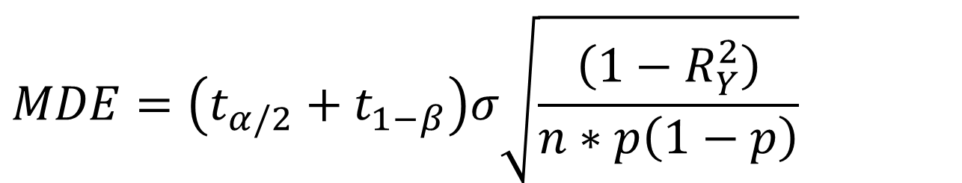
Minimum Detectable Effect (MDE)
What is the smallest impact that will be detected?
n = sample size
p = proportion of sample in treatment group
t = critical value from Student’s t-distribution
R² = R-squared from regression of outcome y on explanatory variables
Assume two-sided test. Note that (t_{.05/2}+t_{.20} )~2.8
$$MDE=\left(t_{α/2}+t_{1−β}\right)σ\sqrt{\frac{\left(1−R_{Y}^{2}\right)}{n∗p\left(1−p\right)}}$$
Think of this as “just some constant”

Slide 7
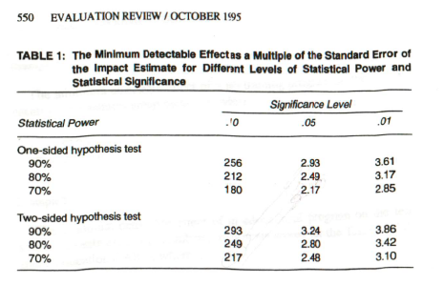
Choosing Power and Significance Level

Slide 8
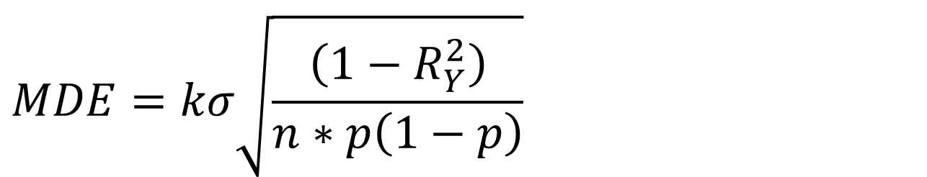
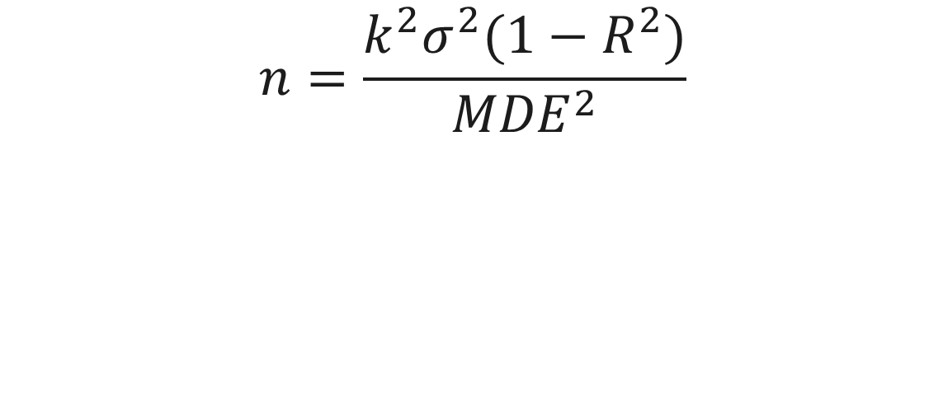
Minimum Detectable Effect (MDE), given n or Sample Size, given MDE
$$MDE=kσ\sqrt{\frac{\left(1−R_{Y}^{2}\right)}{n∗p\left(1−p\right)}}$$
$$n=\frac{k^{2}σ^{2}(1−R^{2})}{{MDE}^{2}}$$

Slide 9
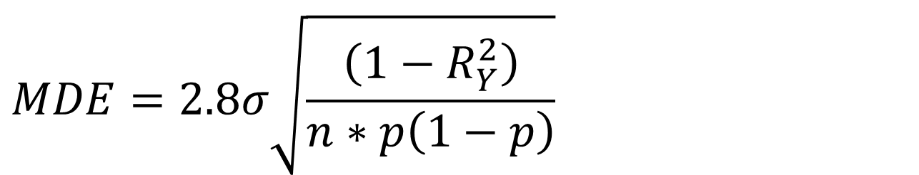
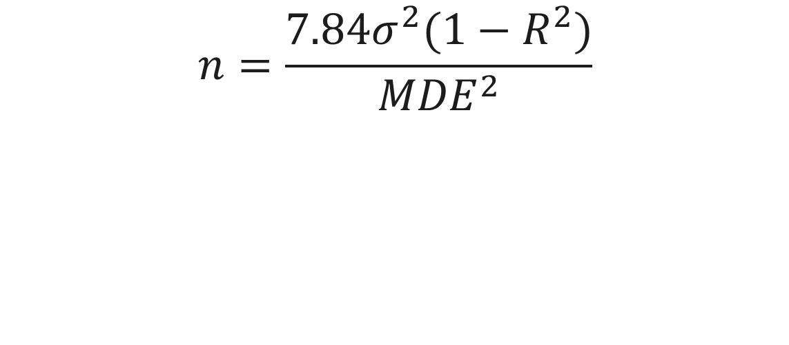
Minimum Detectable Effect (MDE), given n or Sample Size, given MDE
$$MDE=2.8σ\sqrt{\frac{\left(1−R_{Y}^{2}\right)}{n∗p\left(1−p\right)}}$$
$$n=\frac{7.84σ^{2}(1−R^{2})}{{MDE}^{2}}$$

Slide 10

Example: Espacios Para Crecer
Half-day enrichment program for children in grades 1-3
Uses linguistic/culturally appropriate curriculum to motivate children to stay engaged in school and learn to read
Self-esteem building
Recreation: music, sports
Academics
Implemented in DR, Nicaragua
Aims to:
↑ school attachment
↑ literacy skills
↓risky behaviors

Slide 11
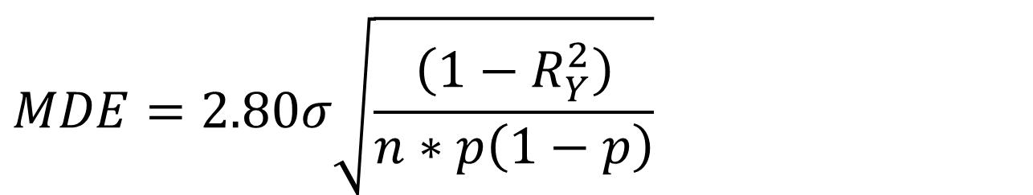
Minimum Detectable Effect (MDE)
Practice exercise:
Your budget allows you to enroll 1,200 children in the study.
a) What is the smallest impact on reading fluency scores (in standard deviations) that you can detect?
n = sample size
p = proportion of sample in treatment group
R² = R-squared from regression of outcome y on explanatory variables
$$MDE=2.80σ\sqrt{\frac{\left(1−R_{Y}^{2}\right)}{n∗p\left(1−p\right)}}$$
2.8*1*SQRT(1/(1200*.5*.5)) = 0.162
b) How much will it help to collect baseline data? Assume they can explain 20% of the variation in fluency.
2.8*1*SQRT((1-0.2)/(1200*.5*.5)) = 0.145

Slide 12
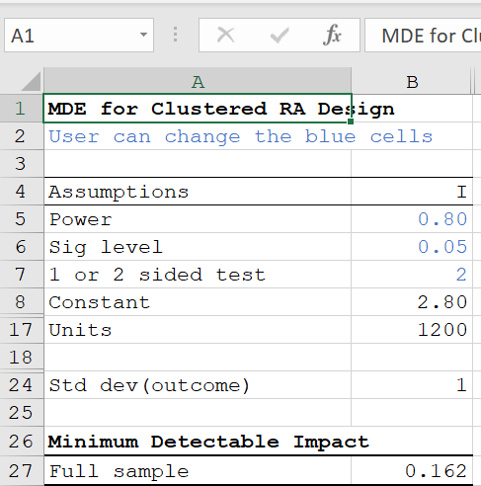
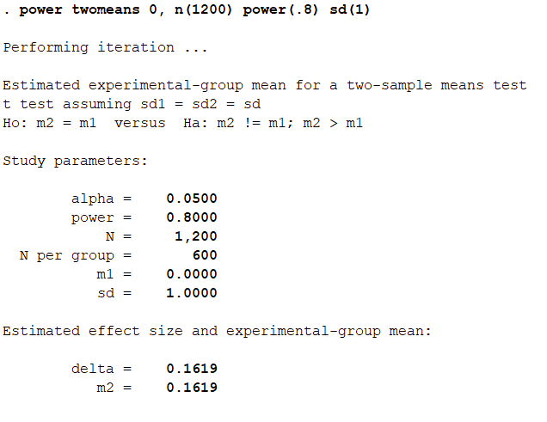
Some tools for calculating MDI
Stata
Excel

Slide 13
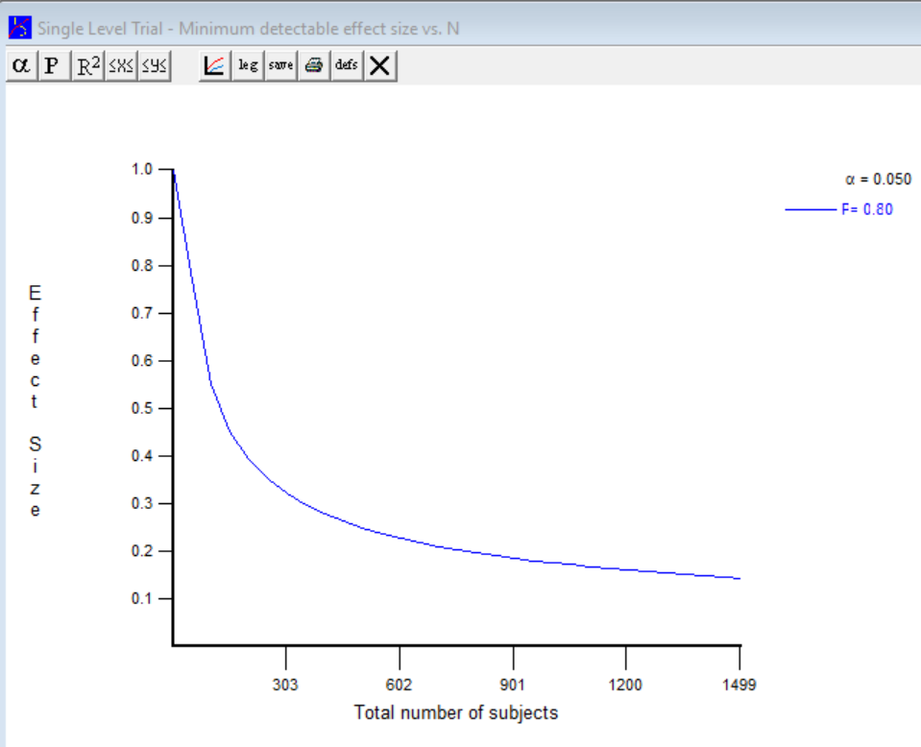
Some tools for calculating MDI
Optimal Design

Slide 14
Other Tools
R Easypower
G*Power
nQuery
DeclareDesign
Stan (example: Kassler et al. 2019)
Do-it-yourself Monte Carlo simulations

Slide 15
Choosing Outcomes
MDI could be different for different outcomes. Choose one that is:
Most important
Hardest to detect an impact (to be conservative)
Has known variance properties
→ Or repeat analysis for each outcome

Slide 16
Choosing Subgroups
Power the study to detect all subgroup impacts
Pre-specify confirmatory analyses. All others are exploratory
In clustered design, may not matter if individual-level subgroup and evenly distributed across clusters
Cluster-level subgroup impacts could be very hard to detect

Slide 17
Choosing Units
Natural units, minimum detectable impact (MDI) vs. minimum detectable effect size (MDES) expressed as standard deviations
Natural units, e.g. number of correct words read per minute, monthly income, are interpretable by policymakers, laypeople
Effect sizes feel unit free, can be compared across studies (but beware, this implicitly equates the reference distribution)
For binary outcomes can use percentage points

Slide 18
Choosing a Target MDI/MDES
Cohen shortcut – don’t use this, it’s not specific enough
“Attainable” impact
Other studies of similar interventions
Preferred: cost-benefit threshold
Forces you to think about cost effectiveness from the outset
For most decisions, it’s what matters, so it’s policy relevant

Slide 19
Study Design Challenge
To implement an EpC you need at least 20 children, but…
How does this affect your power and your proposed design?

Slide 20
Design Wrinkles
Clustering
Stratification or paired randomization
Hybrid design (individual and cluster)

Slide 21
Cluster Randomized Trials

Slide 22
Group- or Cluster-Randomized Trials
Variation at the cluster level, individual level
J = number of clusters
n = cluster size (individuals per cluster)
N = n*J = total individuals in sample
Examples
Households within villages
Students within schools or classrooms
Can be randomized at either level

Slide 23
Group Randomized Trial: Standard Error Formula
Standard error, cluster randomized design with assignment at the cluster level

Slide 24
Intra-class Correlation Coefficient
Intra-class correlation coefficient (ICC) = variation between units/ total variation
Large ICC → need more clusters
Small ICC → can concentrate sample in fewer clusters

Slide 25
ICC Knowledge Check
Which situation would have higher ICC for test scores?
(a) Schools in a city with severe segregation by income
(b) Schools in a city with school choice/open enrollment, admission by lottery, free public transportation
Which variable would typically have a higher ICC?
(a) gender
(b) ethnicity

Slide 26
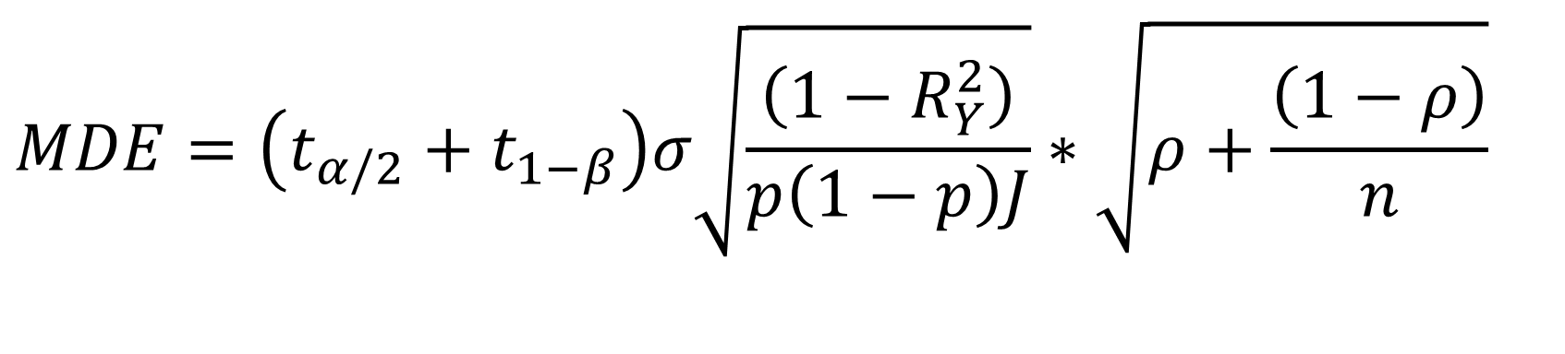
MDE, Group-Randomized Trials
$$MDE=\left(t_{α/2}+t_{1−β}\right)σ\sqrt{\frac{\left(1−R_{Y}^{2}\right)}{p\left(1−p\right)J}}∗\sqrt{ρ+\frac{\left(1−ρ\right)}{n}}$$
Consider case where ρ = .9 → need to minimize k/J * (0.9 + 0.1/n)
Consider case where ρ = .1 → need to minimize k/J * (0.1 + 0.9/n)

Slide 27
Using the Formula
Where do you get ICC, R²?
Most people just make it up or show how sample size requirements (or MDE) varies by ICC
Published estimates from prior studies if available, try to match the unit type and outcome measure, geography if possible

Slide 28
Realized ICCs from USAID-funded LAC Reads Studies
 | Guatemala Quiche Region | Peru Apurimac | Peru San Martín | Peru Ucayali | Nicaragua
ICC fluency | 0.28 | 0.18 | 0.15 | 0.25 | 0.06
ICC reading comprehension | 0.28 | 0.20 | 0.08 | 0.17 | 0.04
Number of schools | 150 | 150 | 200 | 70 | 139
Number of students | 1338 | 1022 | 1642 | 740 | 1106
Grade | 3rd | 3rd | 2nd | 2nd | 1st to 5th

Slide 29
R-squared from USAID-funded LAC Reads Studies
 | Guatemala Quiche Region |  | Peru Apurimac |  | Peru San Martín
 | School | Child | School | Child | School | Child
1. Student pretests | 0.56 | 0.29 | 0.37 | 0.32 | 0.40 | 0.37
2. Student pretests, age, gender, household characteristics | 0.59 | 0.33 | 0.40 | 0.35 | na | na
3. Student pretests, age, gender, school means of pretest | na | na | na | na | 0.51 | 0.37
4. Student pretests, age, gender, school infrastructure | 0.67 | 0.32 | 0.46 | 0.32 | 0.72 | 0.37
5. Student pretests, age, gender, household characteristics, school infrastructure | 0.69 | 0.33 | 0.50 | 0.35 | na | na

Slide 30
Exercise: What is the MDE if we assign entire schools to EpC?
Sample size?
Assume 138 schools, 8 students/school (after attrition)
Intraclass correlation?
Assume ICC = 0.20
BUT, if we can randomize within matched pairs, then the conditional ICC could be much lower, use 0.08
Covariates?
Assume we only have minimal intake data on risk factors, R²=0.10
Other design issues? Takeup rate? Control crossover (i.e. noncompliance)

Slide 31
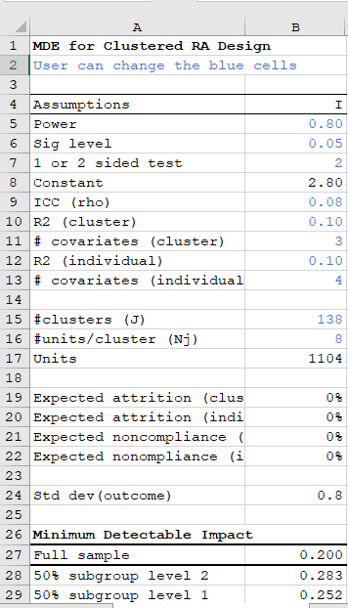
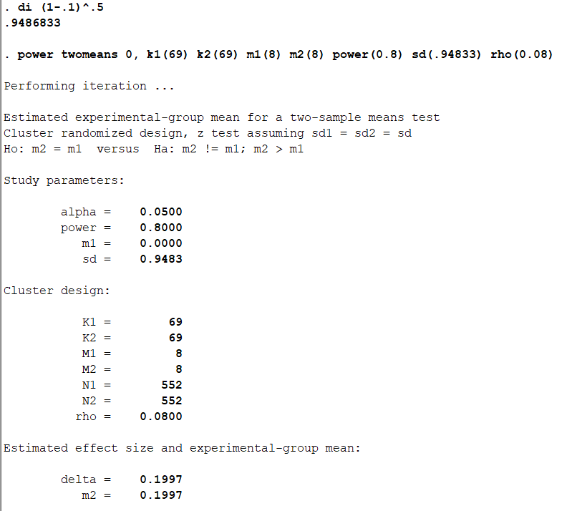
Plug in the numbers…
`

Slide 32
Another wrinkle
Professor Smartypants wants to test four variations on the EpC
The local education authorities want to see impacts reported separately for Spanish, Miskitu, Kriol, and Ulwa speakers
The Ministry of Child Welfare wants to see if there are impacts of EpCs on child labor and initiation of a wide range of risky behaviors
Economist co-PI who doesn’t really care about education asks about impacts on lobster prices?

Slide 33
Multiple comparisons

Slide 34
Multiple Comparisons
What is the problem?
Pr(reject H₀ |H₀, K independent tests) = α
K=1, α = 0.05
K=5, α = 0.23
K=10 α = 0.40
How it arises
Multiple subgroups
Multiple outcomes
Multiple treatments

Slide 35
Studies with Multiple Treatment Arms
Multiple treatment vs. single control
(C, T_{A}, T_{B}, T_{C},…)
Multiple undifferentiated treatments
(T_{A}, T_{B}, T_{C,…})
Structured treatments, e.g. ordered or additive
C, T_{A}, T_{A+B}
T₁₀,T₂₀,T₃₀ (dose-response)
Block design, Latin Square
Factorial design, “cross-cutting treatments”

Slide 36
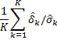
Multiple Comparison Adjustments
Formal adjustment (FWER)
Bonferroni : use α/K
Sequential tests
Formal adjustment (False Discovery Rate)
Benjamini Hochberg (BH)
Data reduction
E.g. mean standardized treatment effect =
Informal adjustment/careful interpretation
See Schochet 2009 Evaluation Review, also Yandell “Practical Data Analysis for Experiments” Chapter 6 (optional)

Slide 37
Traditional (unadjusted) Procedure
Method
Example
Conduct K tests at level α
Compare p-values to α
Reject all null hypotheses where p < α
Contrast | P-value | α
A | .002 | .050
B | .008 | .050
C | .012 | .050
D | .022 | .050
E | .034 | .050
F | .049 | .050
G | .250 | .050
H | .500 | .050

Slide 38
Traditional (unadjusted) Procedure
Method
Example
Conduct K tests at level α
Compare p-values to α
Reject all null hypotheses where p < α
Contrast | P-value | α
A | .002 | .050
B | .008 | .050
C | .012 | .050
D | .022 | .050
E | .034 | .050
F | .049 | .050
G | .250 | .050
H | .500 | .050

Slide 39
Bonferroni Procedure
Method
Example
Conduct K tests at level α
Compare p-values to α/K
Reject all null hypotheses where p < α/K
Contrast | P-value | α/K
A | .002 | .0055
B | .008 | .0055
C | .012 | .0055
D | .022 | .0055
E | .034 | .0055
F | .049 | .0055
G | .250 | .0055
H | .500 | .0055

Slide 40
Bonferroni Procedure
Method
Example
Conduct K tests at level α
Compare p-values to α/K
Reject all null hypotheses where p < α/K
Contrast | P-value | α/K
A | .002 | .0055
B | .008 | .0055
C | .012 | .0055
D | .022 | .0055
E | .034 | .0055
F | .049 | .0055
G | .250 | .0055
H | .500 | .0055

Slide 41
Benjamini-Hochberg Procedure
Method
Example
Conduct K tests at level α
Order p-values low to high
Define k as maximum j for which p(j) >= (j/K)α
Reject all null hypotheses where j = 1,…,k
Contrast | P-value | α(j/K)
A | .002 | .006
B | .008 | .013
C | .012 | .019
D | .022 | .025
E | .034 | .031
F | .049 | .038
G | .250 | .044
H | .500 | .050

Slide 42
Benjamini-Hochberg Procedure
Method
Example
Conduct K tests at level α
Order p-values low to high
Define k as maximum j for which p(j) >= (j/K)α
Reject all null hypotheses where j = 1,…,k
Contrast | P-value | α(j/K)
A | .002 | .006
B | .008 | .013
C | .012 | .019
D | .022 | .025
E | .034 | .031
F | .049 | .038
G | .250 | .044
H | .500 | .050

Slide 43
Multiple comparisons in factorial experiments
Specify contrasts to test in pre-analysis plan
Run hypothesis test procedures specific to multiple contrasts
For example, many treatments each vs. control; allocate larger sample to control group
Dunnett’s t-test
Duncan’s multiple range test

Slide 44
Principles for Avoiding Multiple Comparison Inference Problems
Don’t ignore multiple comparisons
Limit outcomes and subgroups
Structure the data first, choose correction procedures before seeing the data
Distinguish confirmatory versus exploratory analysis

Slide 45
Quasi-experimental design

Slide 46
Power calc for a quasi-experimental design
There really should be a penalty to acknowledge that you are using part of your sample to identify the treatment effect
Matching
→ “Common support condition” means you have to discard sample
Instrumental variables/regression discontinuity
→ Penalty a function of the R-squared of running variable (instrument) explaining participation

Slide 47
Precision of the Regression Discontinuity (RD) Design
R²_{T} = proportion of Var(T) explained by rating and covariates
Where T = 1 if Z>z*; 0 if Z<=z*
It’s a measure of collinearity among the covariates. If collinearity is high, ability to precisely estimate effects of any one covariate is lower.

Slide 48
MDE for Propensity Score Matching
Conditions that will affect power:
Cases lost to common support condition
Matching model and algorithm search

Slide 49
¿Preguntas?
?
?
?
?
?
?

